Slide 1
State of the Order
Wednesday, October 22, 2014
Deacon Tom Bello

Slide 2
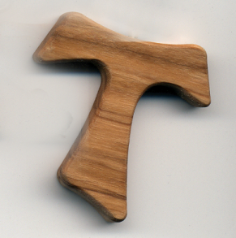
Come Holy Spirit!
NAFRA
Chapter
2014
Dallas,
TX

Slide 3
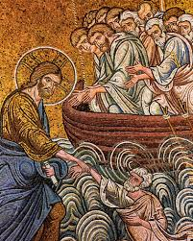
Chapter
2014
Dallas,
TX
When the disciples saw him walking on the sea they were terrified. “It is a ghost,” they said, and they cried out in fear. At once Jesus spoke
to them, “Take courage, it is I; do not be afraid.” Peter said to him in reply,
“Lord, if it is you, command me to come to you on the water.”
He said, “Come.” Peter got out of the boat and began to walk on the water toward Jesus. But when he saw how strong the wind was he became frightened; and,
beginning to sink, he cried out, “Lord, save me!” Immediately Jesus
stretched out his hand and caught Peter, and said to him,
“O you of little faith, why did you doubt?”
Matthew 14:26-31

Slide 4
Chapter
2014
Dallas,
TX
“Jesus Never Invites Us To Failure!”

Slide 5
Chapter
2014
Dallas,
TX

Slide 6
By The Numbers
Chapter
2014
Dallas,
TX
By best guess, NAFRA, the Secular Franciscan Fraternity of the United States, has reported 12,739 active professed members to CIOFS. This is down 264 members from the 13,003 active, permanently professed members nationwide I reported in my 2013 Annual Report, which is over 200 less than our average decline of 468 members for the preceding six years, as reported in that 2013 Annual Report.
We currently have 1014 Candidates, which is only down 42 Candidates from our 2013 numbers, which had seen a drop of 100 Candidates from 2012, by comparison. And this year we report 637 canonically established fraternities, which is up 31 fraternities from the 606 we reported in 2012, an increase of just over one canonically established fraternity per Region, and even our National Fraternity can report continued growth and stability in the St. Padre Pio emerging Fraternity in the United States Territory of Guam. Congratulations and thanks to all!

Slide 7
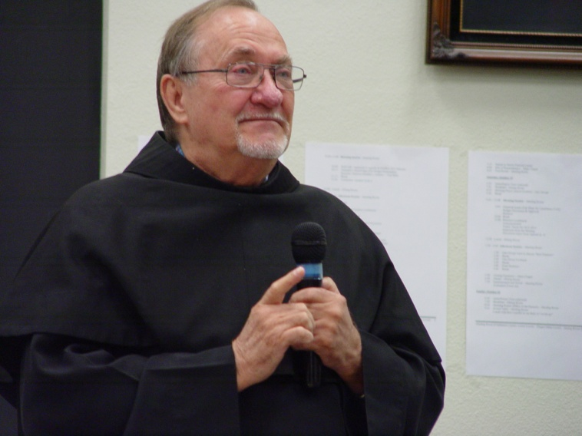
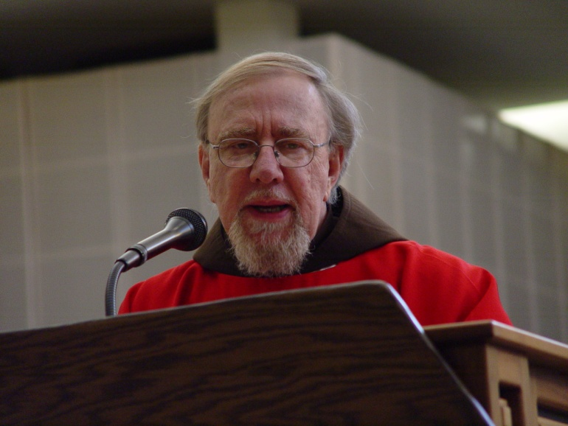
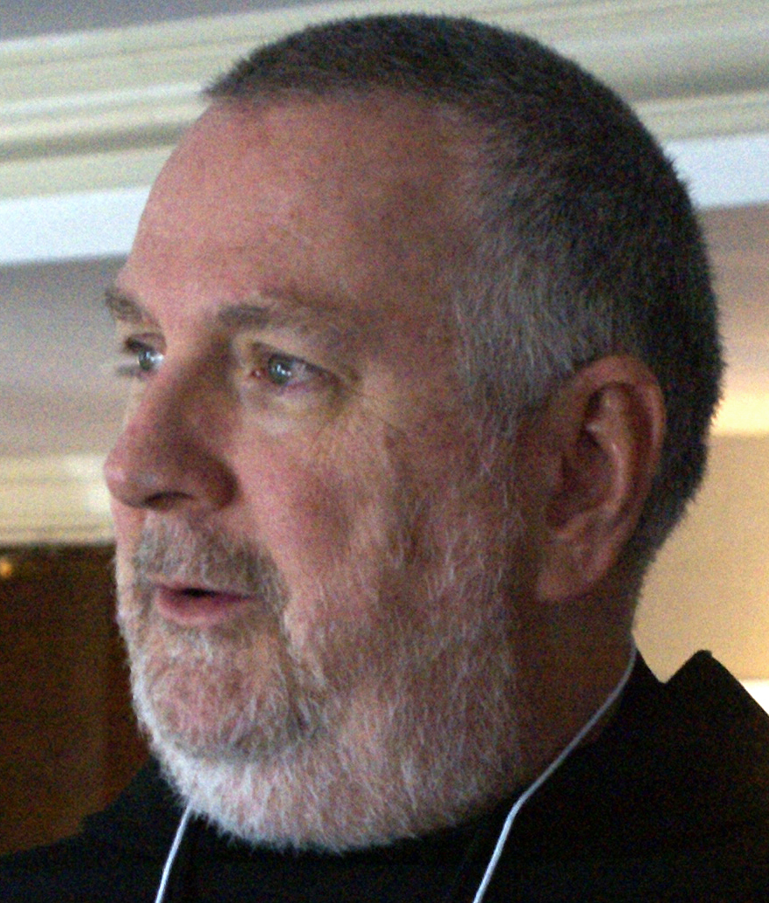
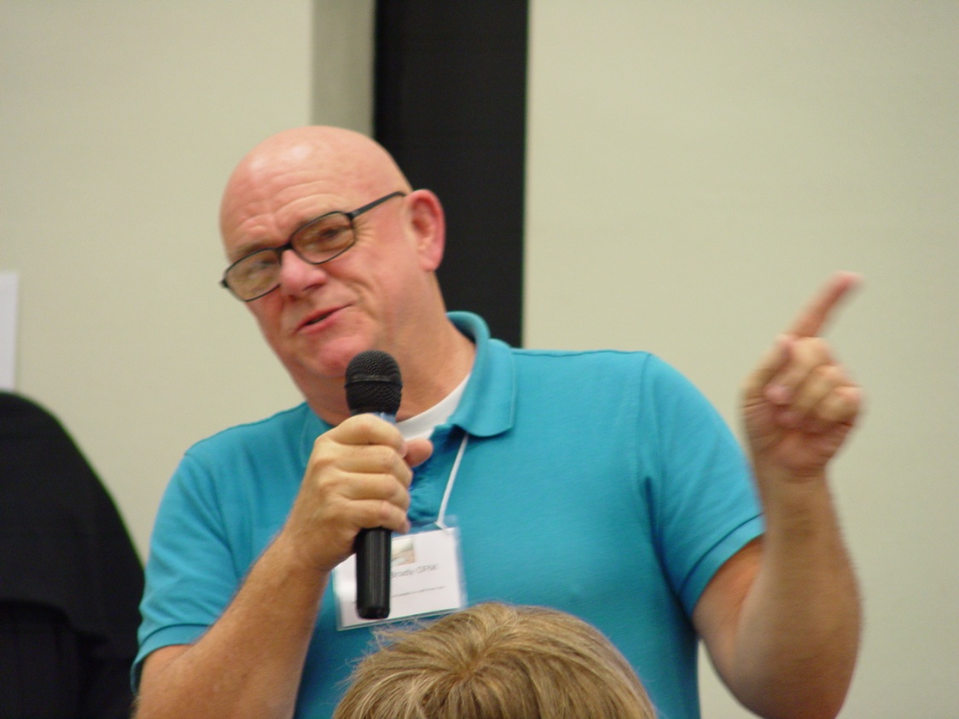
Spiritual ASSISTANCE
Chapter
2014
Dallas,
TX

Slide 8
Spiritual ASSISTANCE
Chapter
2014
Dallas,
TX
1. Seminars on Spiritual Assistance
2. Spiritual Assistants’ Workshops
3. Spiritual Assistance Training
4. Retreats
5. National “Challenge”

Slide 9
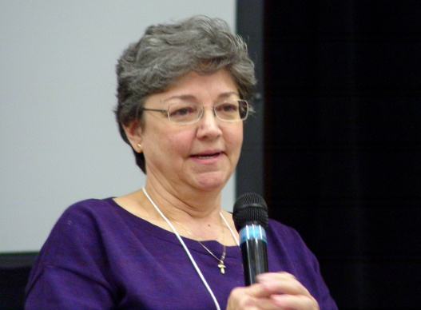
FORMATION
Chapter
2014
Dallas,
TX
1. Essential Information
2. Effective Lifelong Formation
3. Spiritual, Even Social & Organizational, Transformation

Slide 10
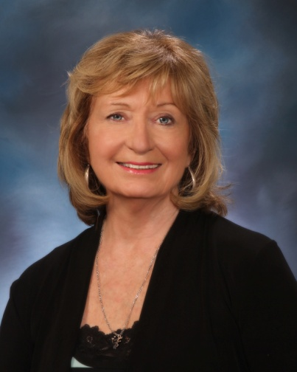
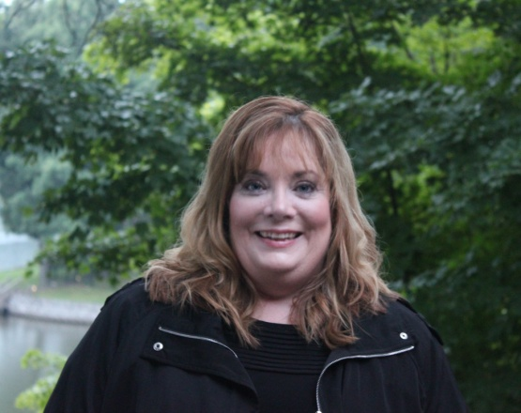
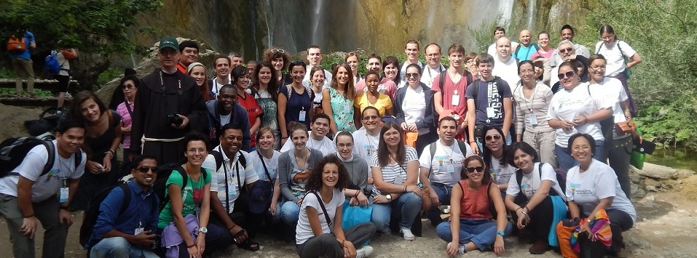
YOUTH & YOUNG ADULTS
Chapter
2014
Dallas,
TX
UNDER 35 YEARS OLD <1% 50 TO 65 YEARS OLD 35%
35 TO 50 YEARS OLD 8% 66 AND OVER 56%

Slide 11
JUSTICE, PEACE & INTEGRITY OF CREATION
Chapter
2014
Dallas,
TX

Slide 12
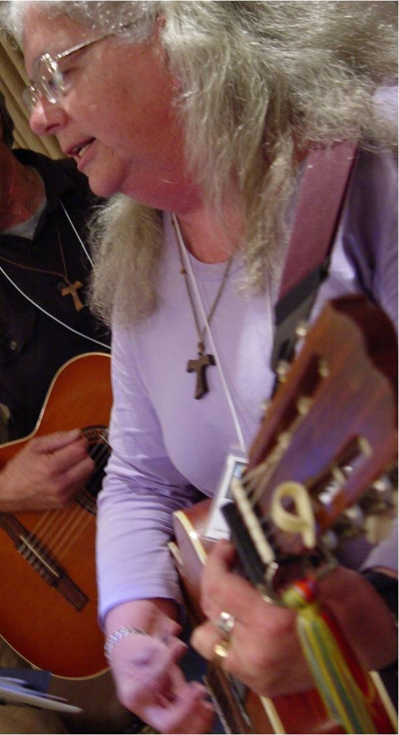
COMMUNICATION
Chapter
2014
Dallas,
TX
1. Website
2. TAU-USA
3. eMail/Listservs
4. Social Media
5. Translations

Slide 13
VOCATIONS
Chapter
2014
Dallas,
TX
O, Good and Gracious God,
God of mercy, compassion, generosity, and love,
As we live our lives today in the model of St. Francis,
choosing daily to live the Gospel life,
Help us to help others hear Your call.
Help us to help others to recognize
their vocation as a Secular Franciscan
that You have already planted in their heart.
Help us, so that together we all may work
to bring the Gospel to life. Amen!

Slide 14
OUR FOUR FRATERNIES
Chapter
2014
Dallas,
TX

Slide 15
Chapter
2014
Dallas,
TX
“Jesus Never Invites Us To Failure!”

